Slide 1
MSc Project Presentation
John Booth
August 2019

Slide 2
Methods

Slide 3
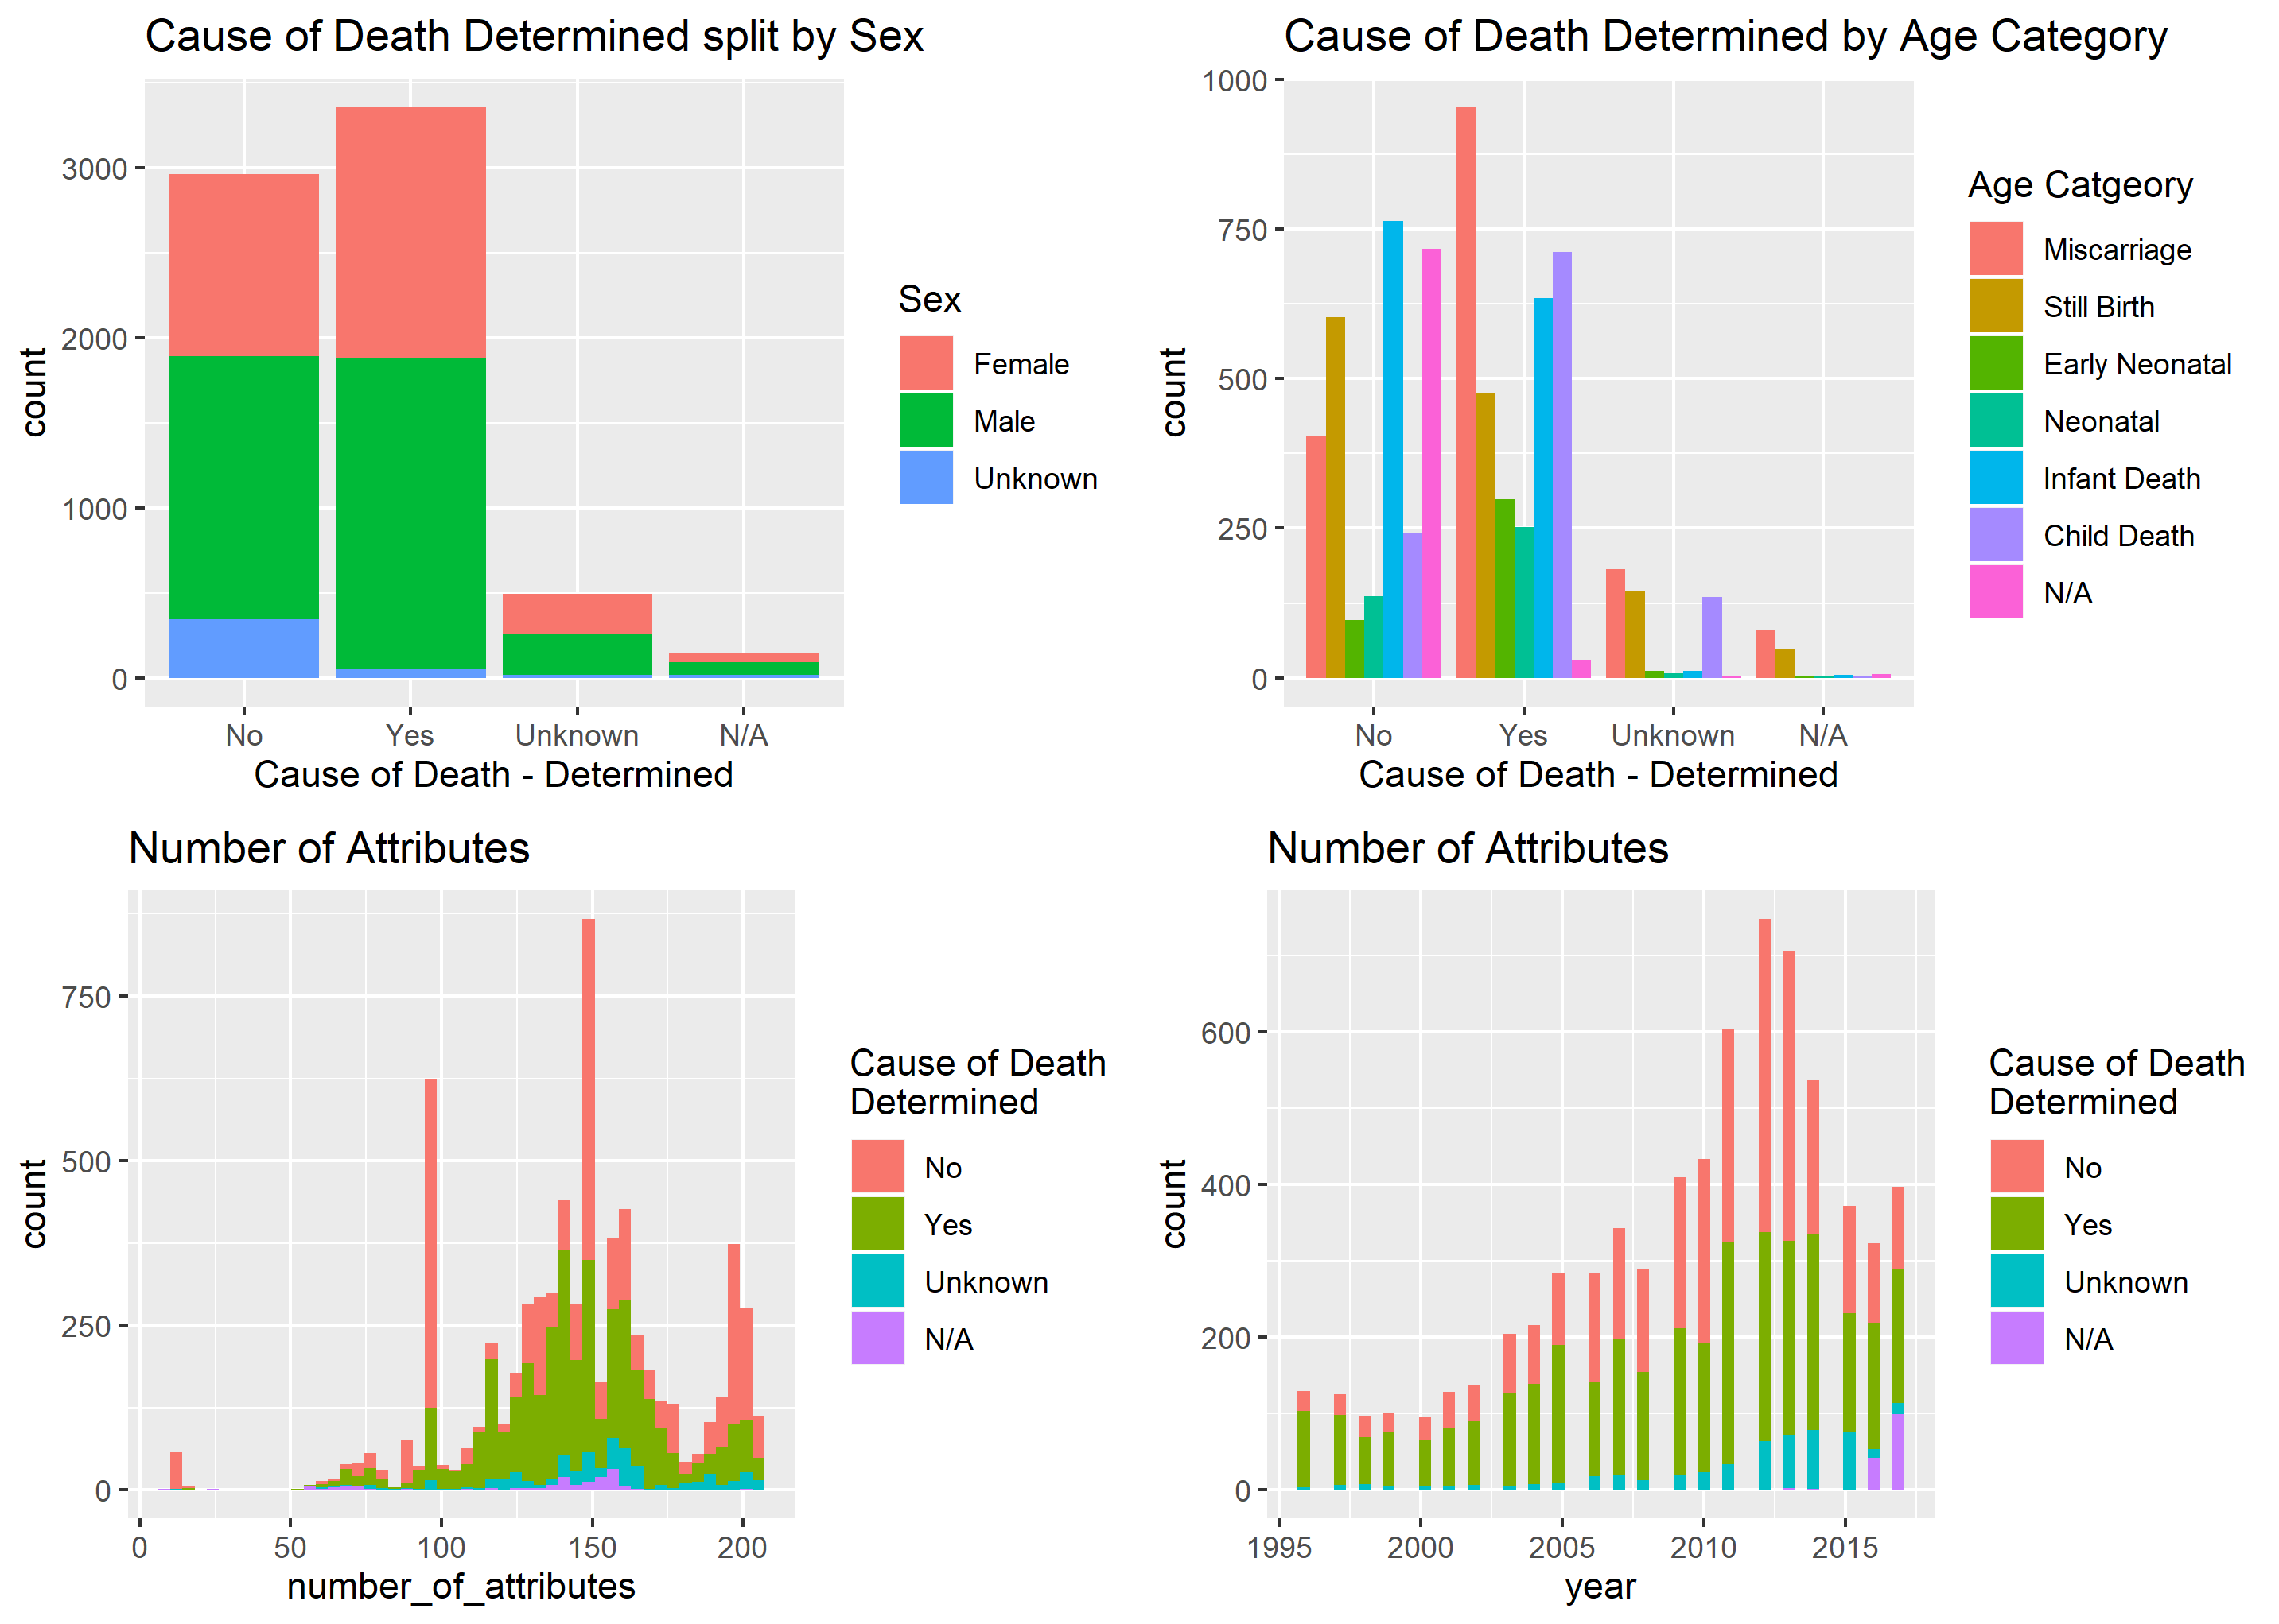
Data

Slide 4
Analysis

Slide 5
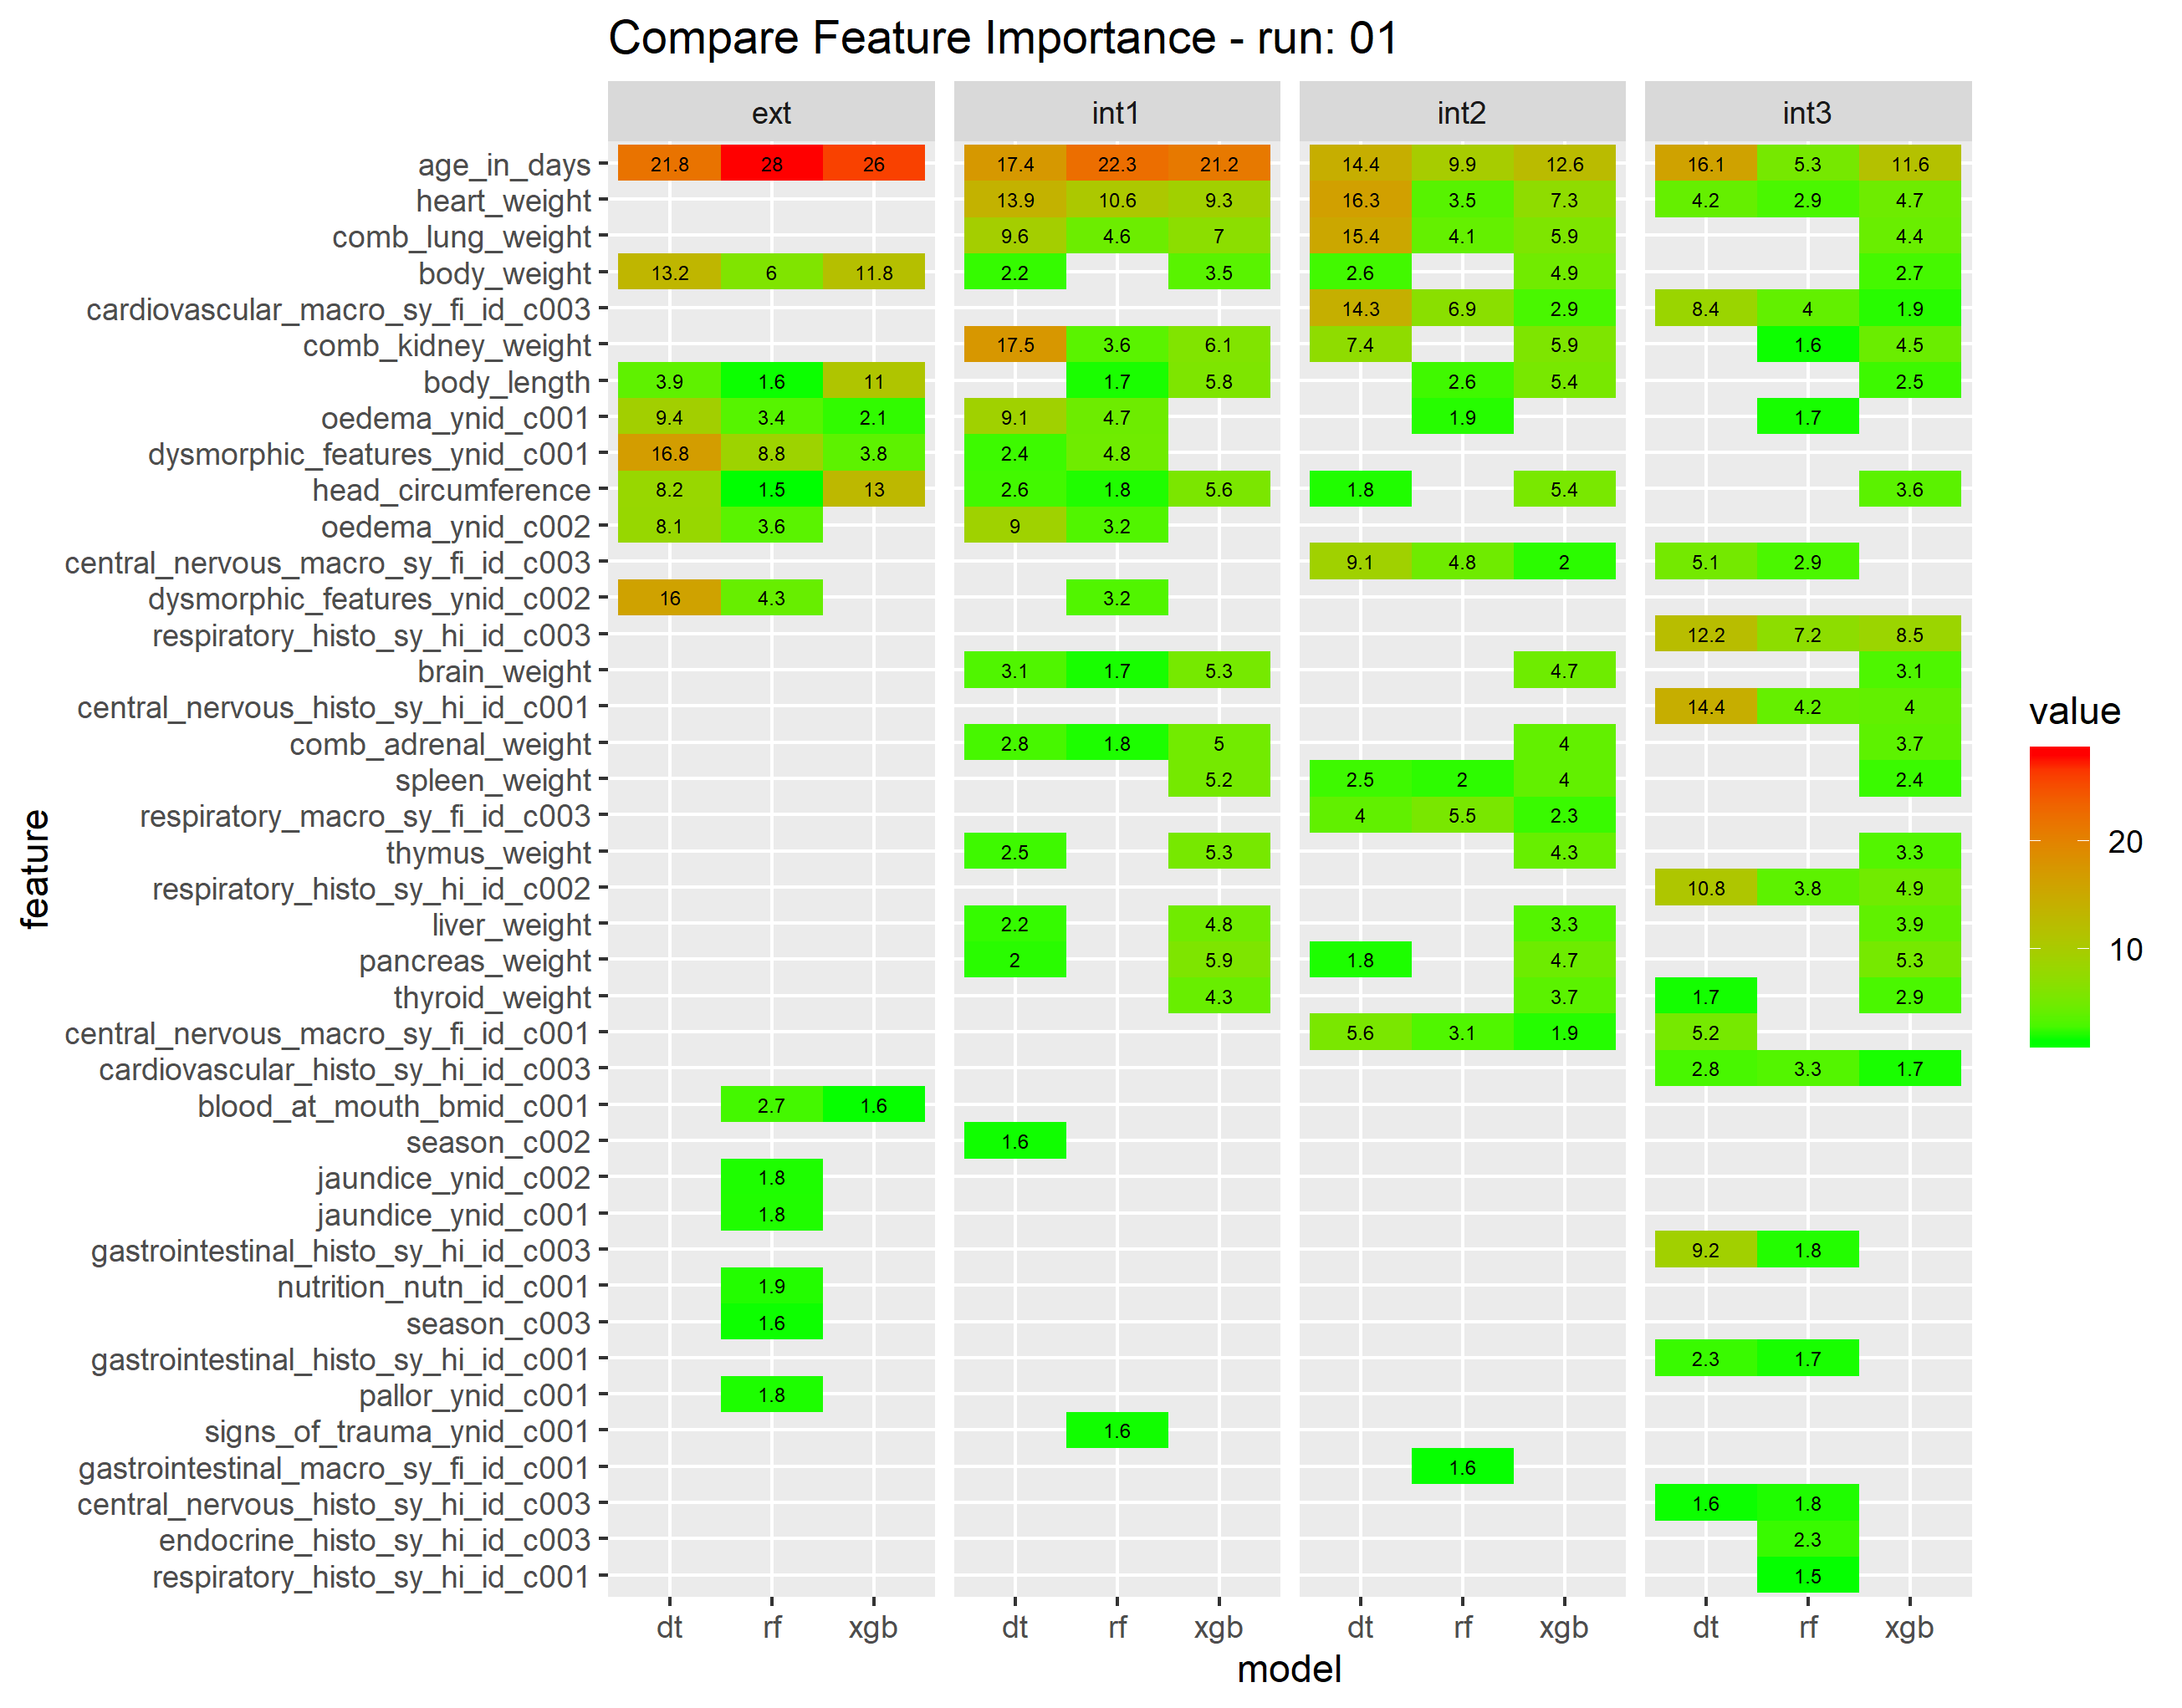
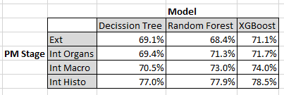
Results
The above percentages are the predictive accuracy of the three models with the data accumulated at the different stages of a post mortem. The numbers are derived from the mean of 5 runs using different random seeds for each run.
The heat map shows the change in feature importance as additional features are added at each stage of the post mortem as determined by the three models.

Slide 7
POWERED BY ANALYTIXAGILITY

